Slide 1

Remote Office Integration with Data Center Using Routing and Access Control

Slide 2
Problem Statement
Scenario: A company has set up a remote office that requires access to the data center for file sharing, internal applications, and web services. The remote office connects via a leased line (MPLS or dedicated line) and requires secure, efficient communication.
Requirements:
● Configure static and dynamic routing between the data center and the remote office.
● Implement EIGRP or OSPF for automatic route distribution and redundancy.
● SetupACLstoallow traffic only for specific services (e.g., block non-essential ports such as FTP while allowing HTTPS).
● Create route filters and route maps to control route advertisement between the remote office and the data center to optimize routing paths and reduce unnecessary traffic

Slide 3
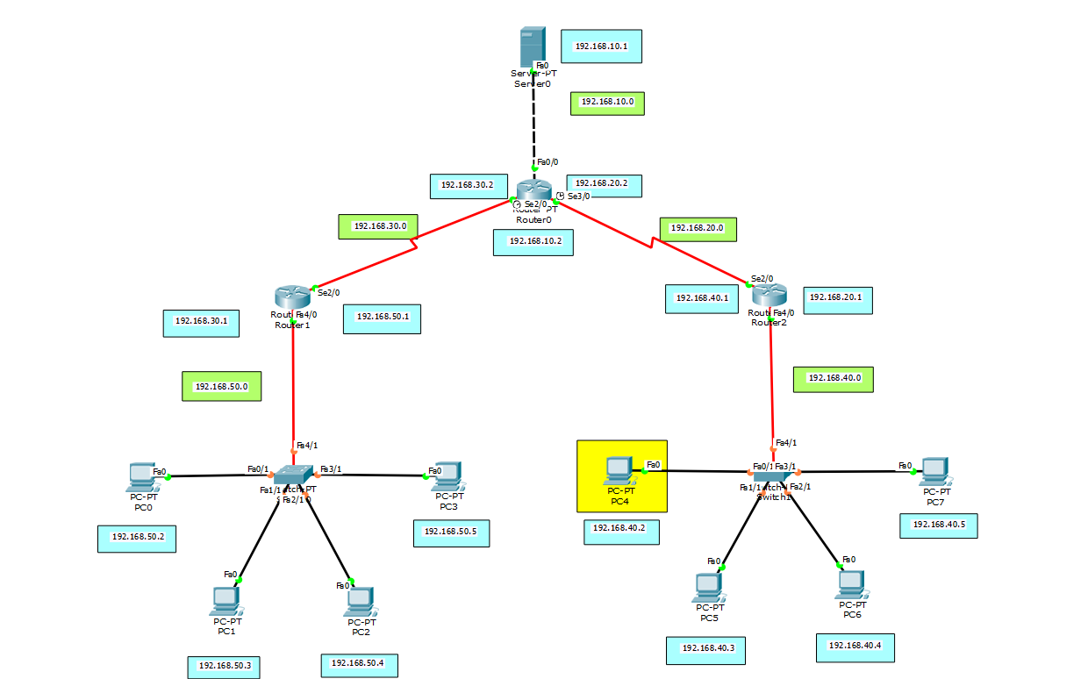
Structure

Slide 4
Uesed protocols
Static routing
Dynamic routing (OSPF)
ACL (for specifically blocking FTP traffic and allowing HTTP traffic)

Slide 5
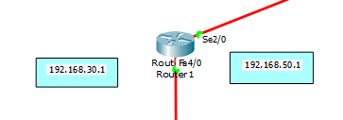
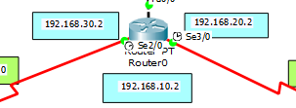

Router configuration
en
conf t
int Se2/0
ip add 192.168.30.1 255.255.255.0
exit
int Fa4/0
ip add 192.168.50.1 255.255.255.0
exit
en
conf t
int Se2/0
ip add 192.168.30.2 255.255.255.0
exit
int Se3/0
ip add 192.168.20.2 255.255.255.0
exit
int Fa0/0
ip add 192.168.10.2 255.255.255.0
exit
en
conf t
int Se2/0
ip add 192.168.20.1 255.255.255.0
exit
int Fa4/0
ip add 192.168.40.1 255.255.255.0
exit

Slide 6
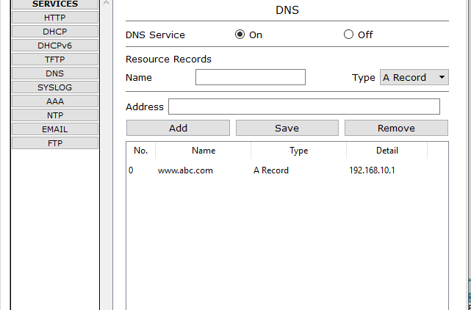
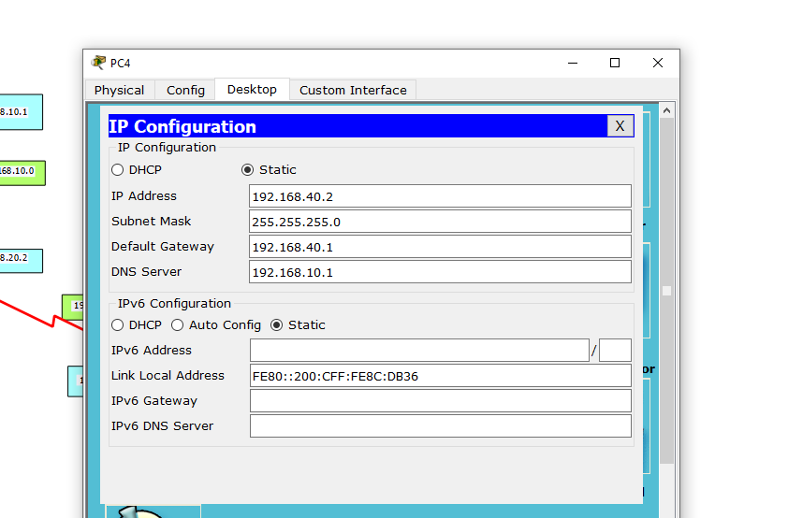
DNS server and PC config

Slide 7
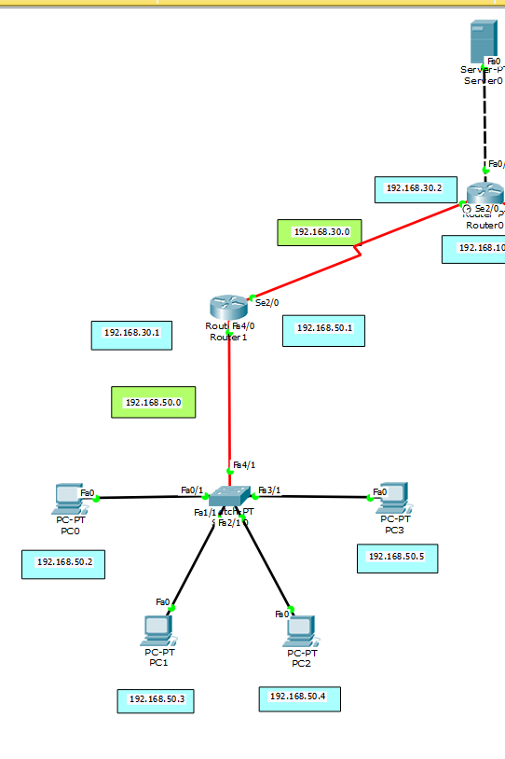
Dynamic routing(OSPF)
Router 1
router ospf 1
network 192.168.50.0 0.0.0.255 area 5
network 192.168.30.0 0.0.0.255 area 5
exit
Router 0
router ospf 1
netowrk 192.168.10.0 0.0.0.255 area 5
network 192.168.20.0 0.0.0.255 area 5
network 192.168.30.0 0.0.0.255 area 5

Slide 8
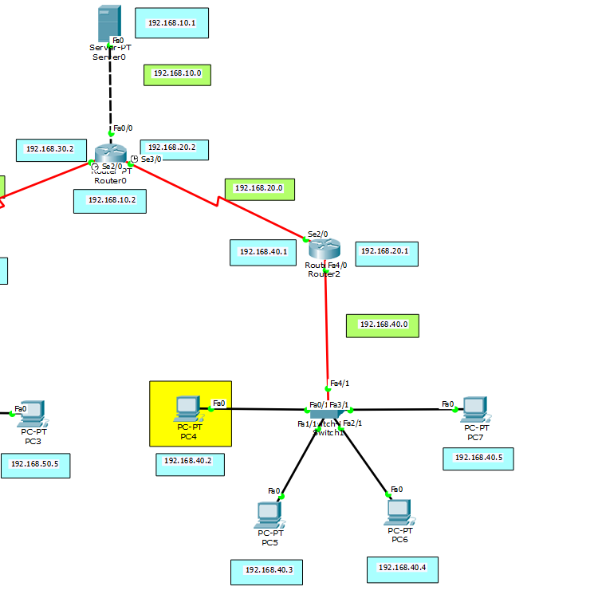
Static routing
Router 2
int se2/0
ip route 192.168.10.0 255.255.255.0 192.168.20.2
Router 0
int se3/0
ip route 192.168.40.0 255.255.255.0 192.168.20.1

Slide 9
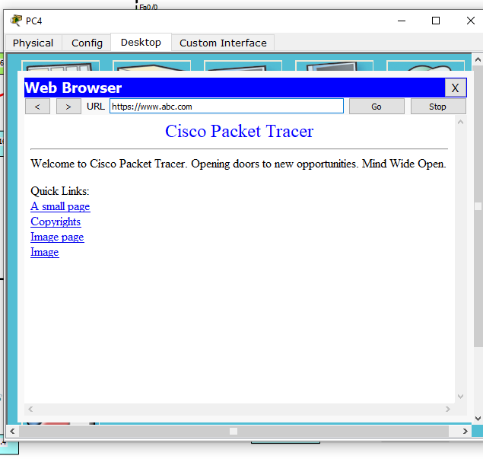

HTTPS is allowed

Slide 10
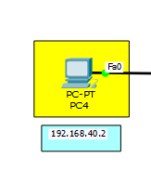
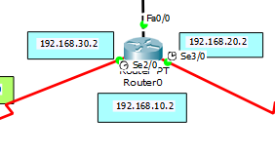
ACL (For blocking FTP traffic and allowing HTTPS)
Router 0
en
conf t
access-list 100 deny tcp host 192.168.40.2 host 192.168.10.1 eq 21
access-list 100 permit ip any any
int fa0/0
ip access-group 100 out
exit

Slide 11
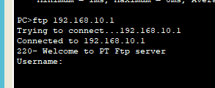
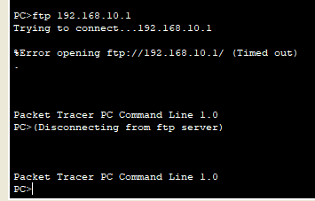
Before and After applying ACL
Before applying ACL
After applying ACL

Slide 12
Thank you

